Slide 1
Single-cell RNA sequencing reveals the immune biomarkers involved in T-cells exhaustion in pancreatic adenocarcinoma

Slide 2
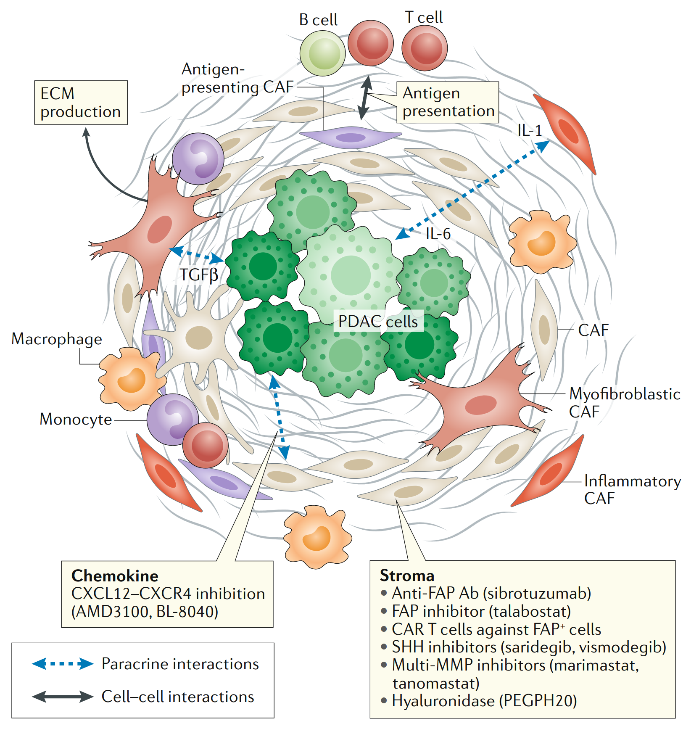
Pancreatic Adenocarcinoma (PDAC)
PDAC is one of the most lethal solid tumours despite the use of multi-agent conventional chemotherapy regimens
Exploring the PDAC tumor microenvironment (TME) holds promise as a potential immunotherapeutic target
Ho, W. J., Jaffee, E. M., & Zheng, L. (2020). The tumour microenvironment in pancreatic cancer — clinical challenges and opportunities. Nat. Rev. Clin. Oncol., 17, 527–540. doi: 10.1038/s41571-020-0363-5

Slide 3
Study Objective
The objective of the study is to identify the exhaustive immune marker genes in different T-cell types implicated in various pro-cancer pathways leading to towards exhaustive immune system

Slide 4
Methodology
ScRNA-seq Analysis Alignment of reads to reference genome using STARsolo quality control, normalization, scaling, feature selection, and clustering using Seurat package Cell annotation using ScTypeDB Differential gene expression and marker genes identification using Seurat package
Enrichment analysis for poor survival pathways using GeneCodis4 (https://genecodis.genyo.es/)
T-cell exhaustive genes shortlisting through literature review
Expression and survival analysis using TCGA/GEPIA2 (PAAD) (http://gepia2.cancer-pku.cn/)
Ridge, violin and feature plots for shortlisted genes using Seurat

Slide 5
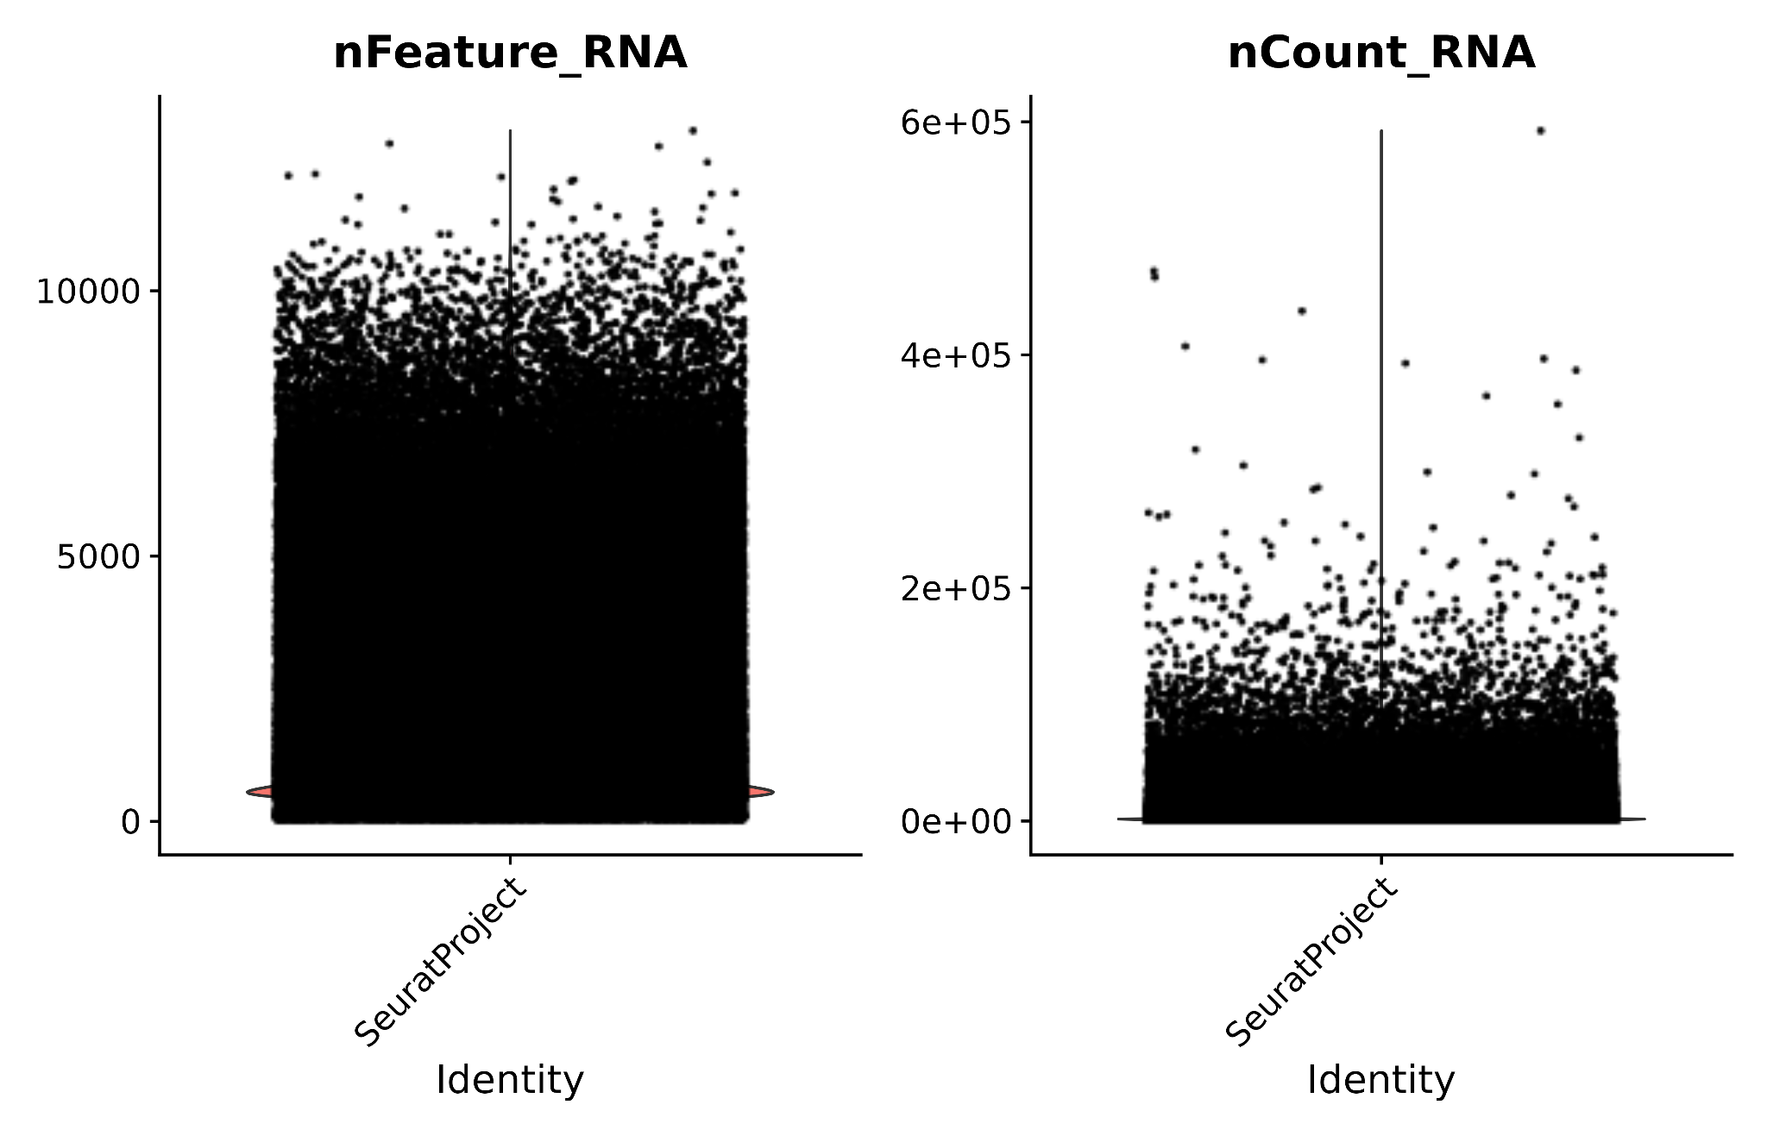
Quality Control
1. Removal of Undesired Features
Quality control was performed to remove the cells with undesired features, including dead cells and cells with higher and lower expression levels.

Slide 6
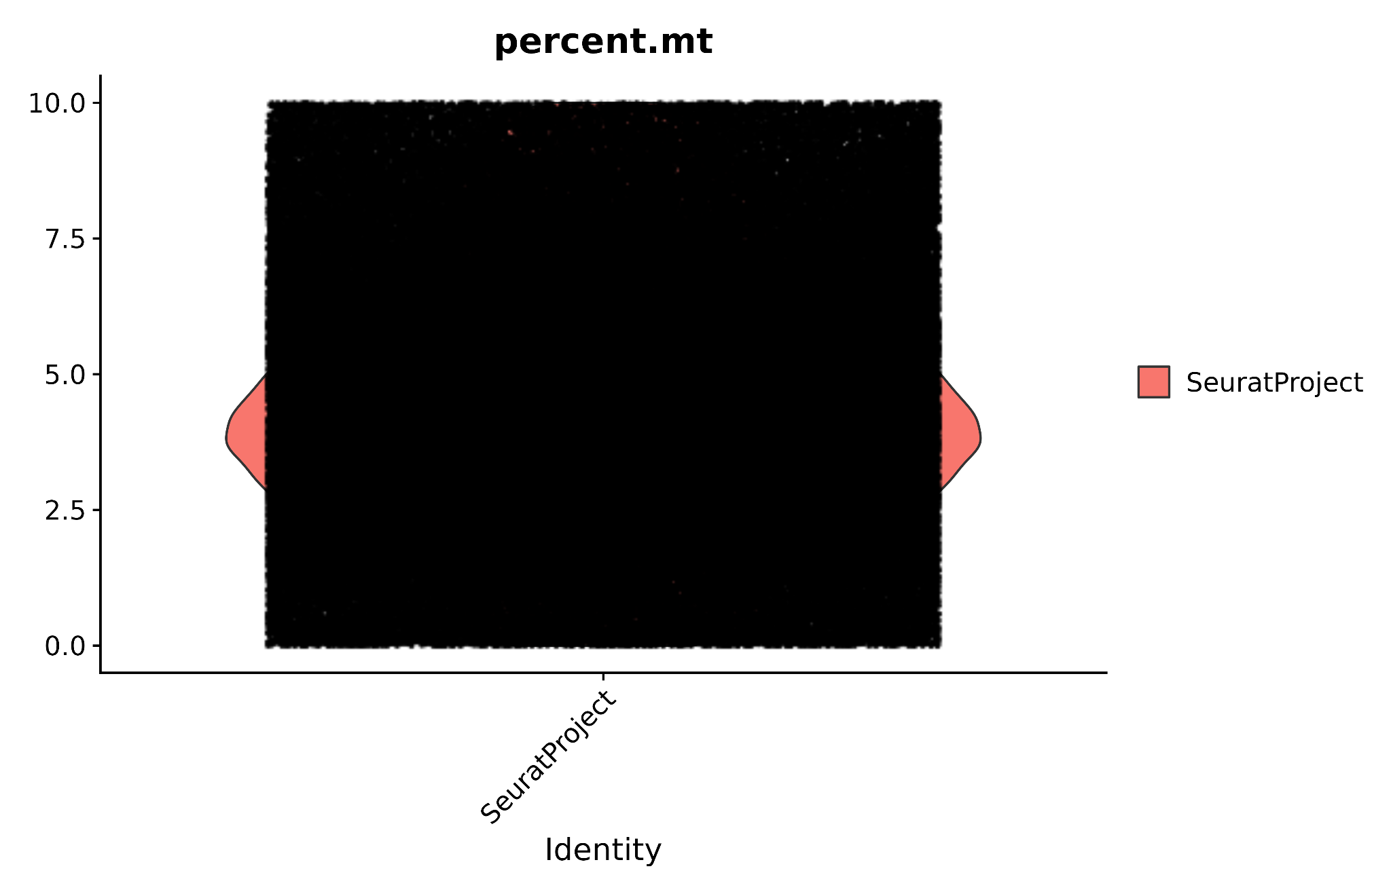
2. Mitochondrial Reads
The cells exhibiting increased levels of mitochondrial reads greater than 10% were eliminated from the data to avoid potential confounding outcomes.

Slide 7
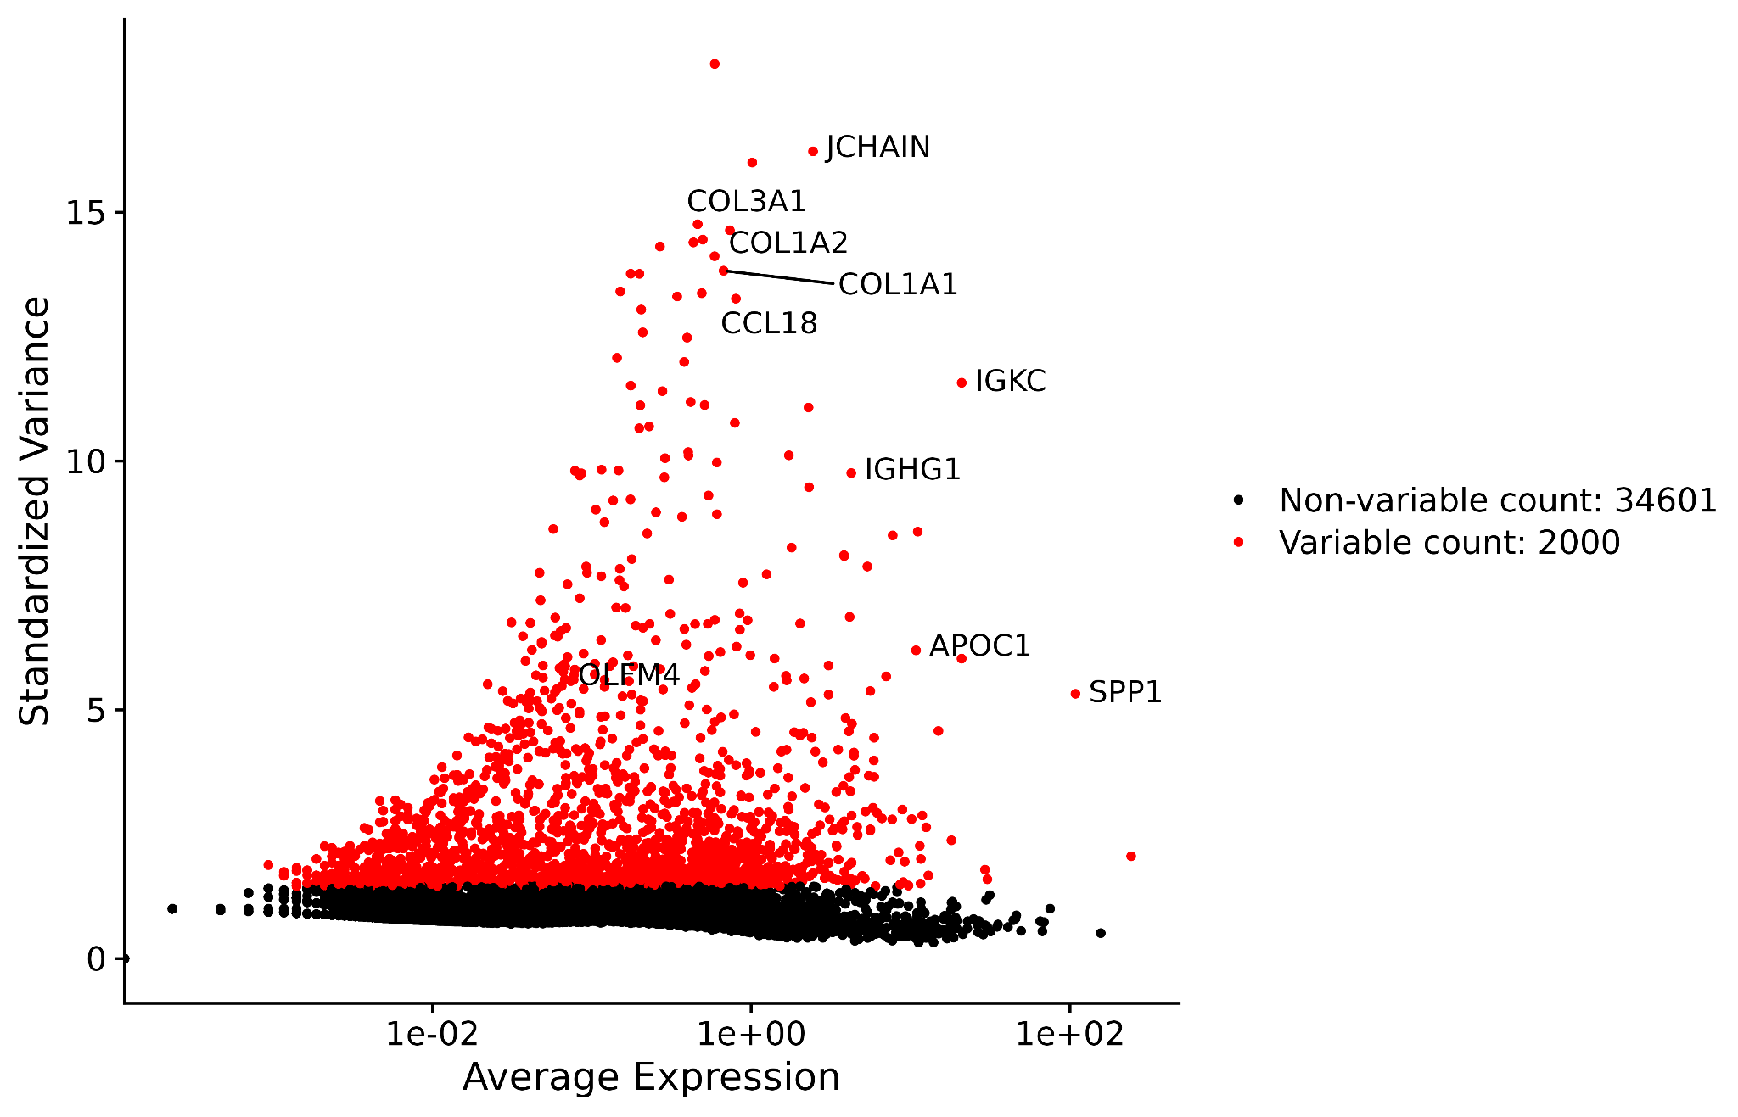
3. Highly Variable Features
A set of 2000 genes with significant variability was selected to identify significantly higher expressed genes.
JCHAIN, COL3A1, COL1A2, COL1A1, CCL18, IGKC, IGHG1, APOC1, SPP1, and OLFM4 were the top 10 highly variable genes.

Slide 8
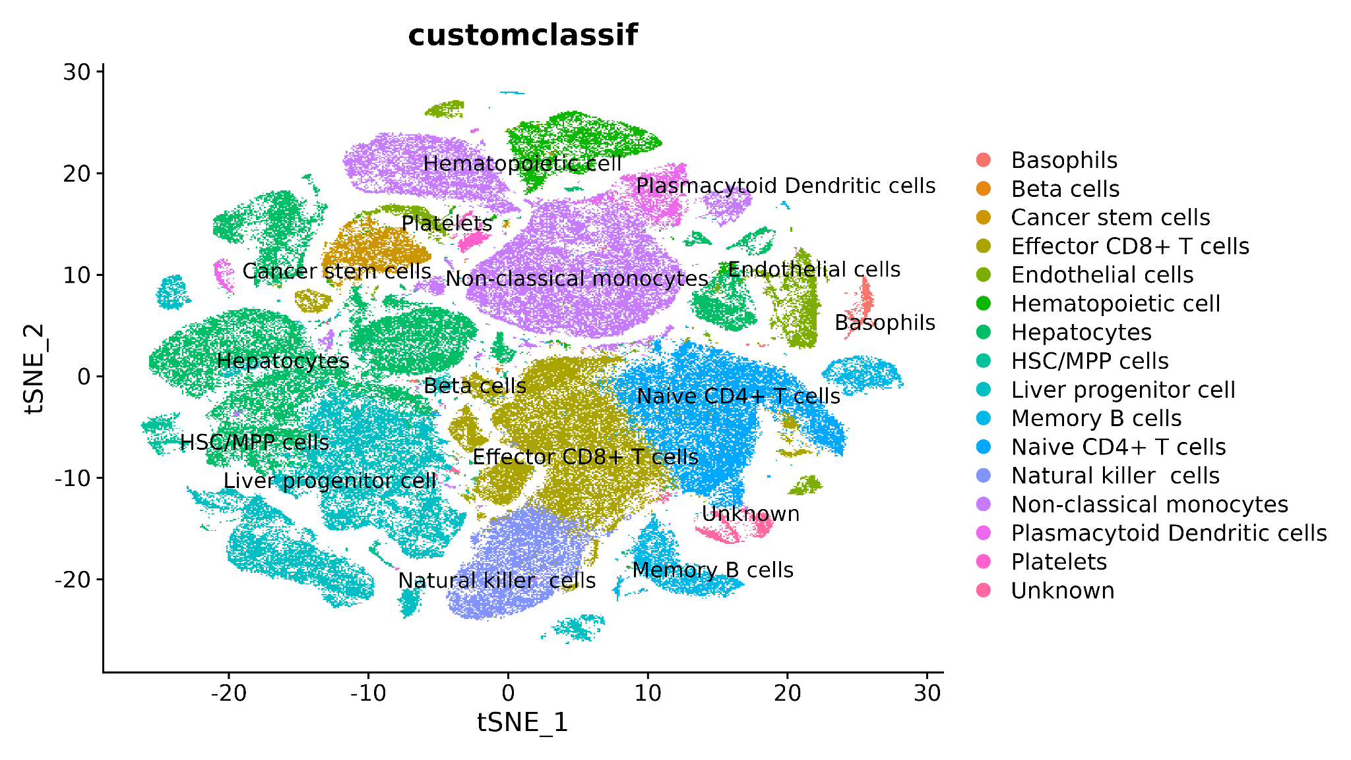
Clustering and Annotation
The t-SNE was employed for visualization, revealing distinct cell subpopulations and structure and heterogeneity within the data.
All the annotated cell subpopulations are mentioned in Figure.
Notes:
Multiple cells types were observed across the dataset such as effector T-cells, basophils and natural killer cells among others

Slide 9
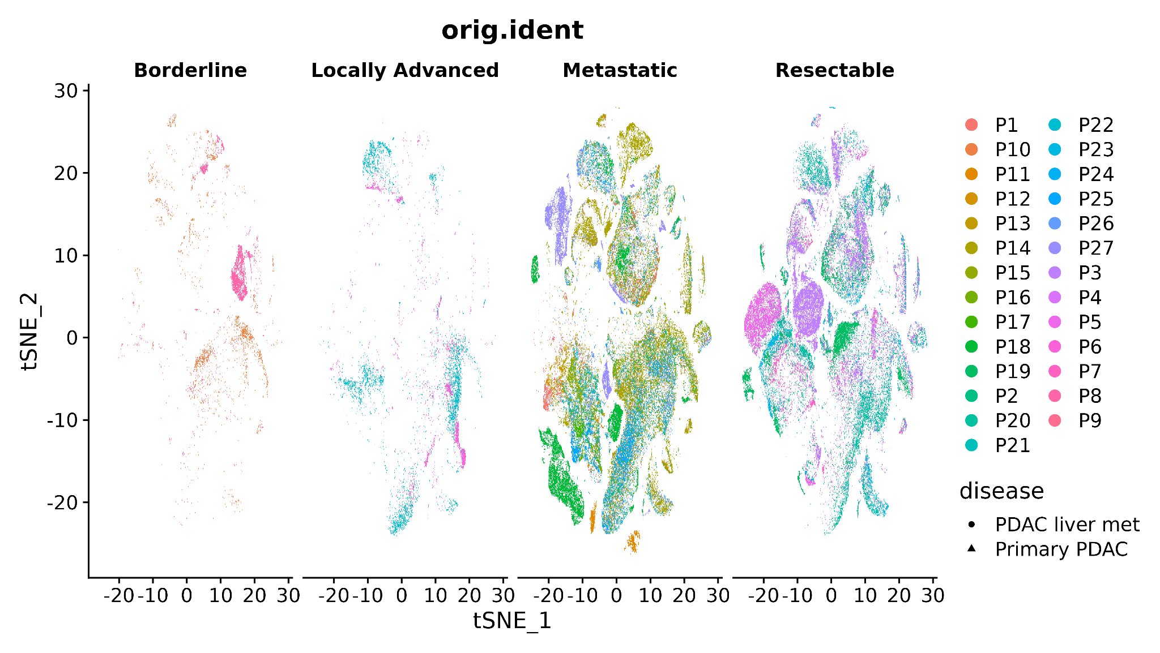

Slide 10
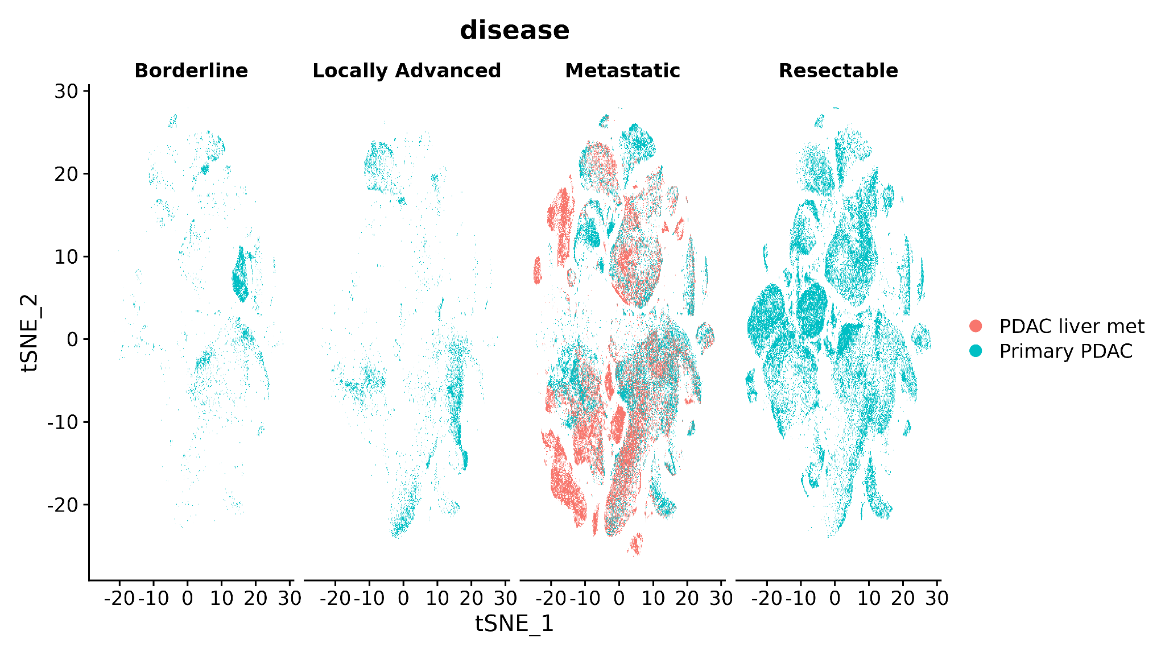

Slide 11
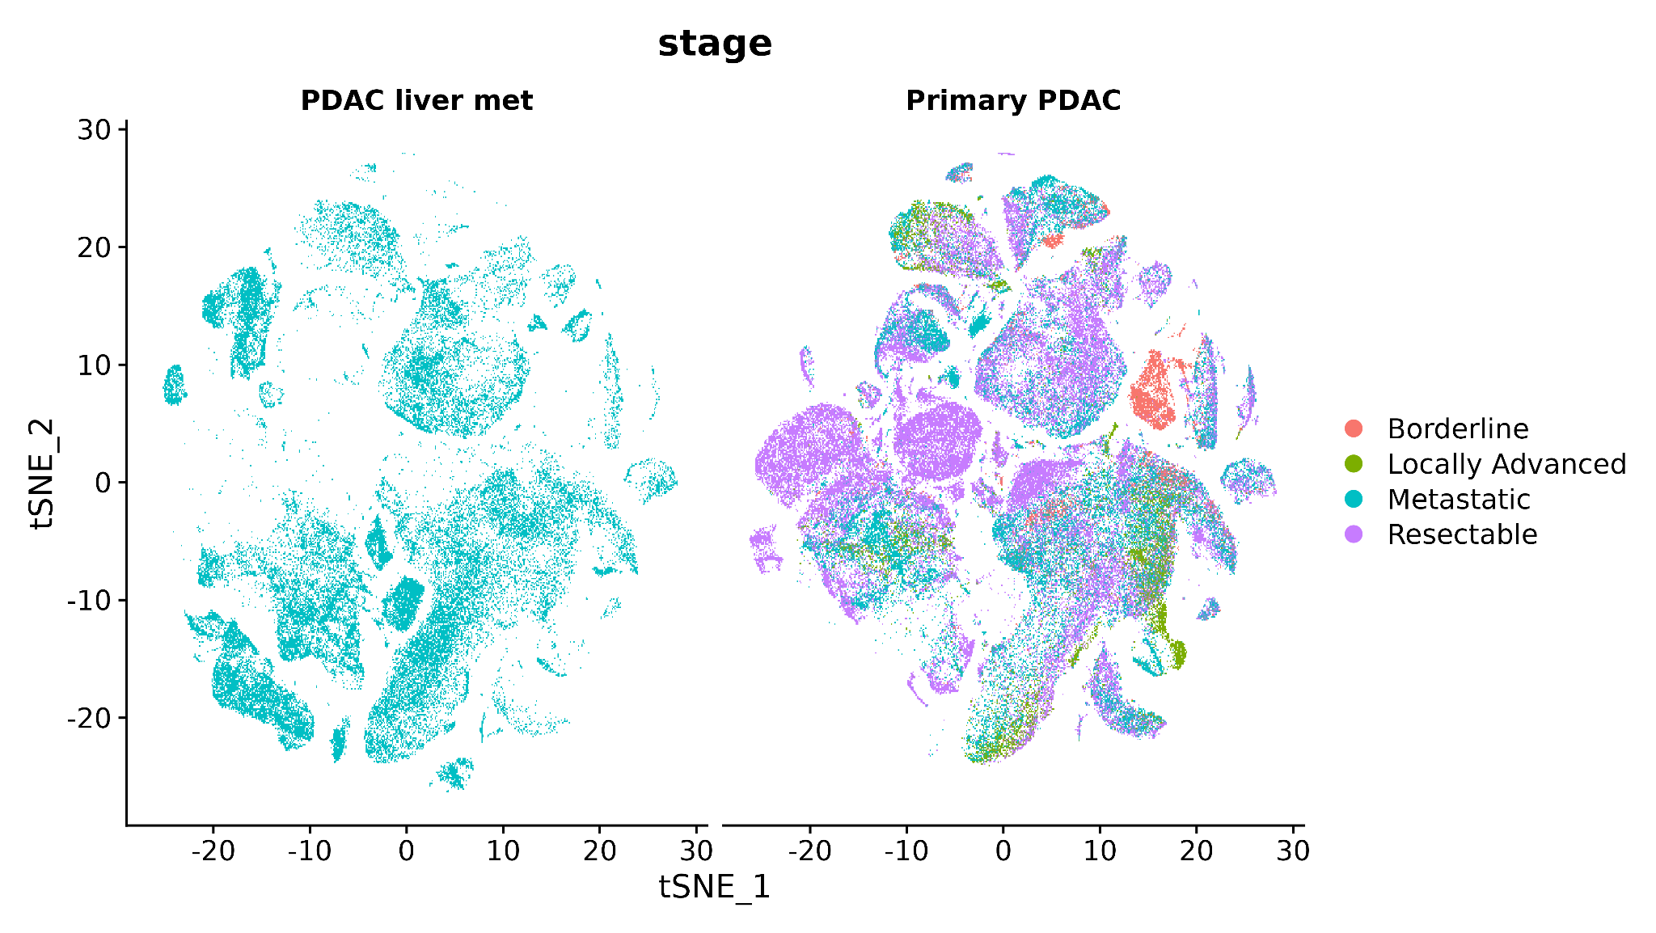

Slide 12
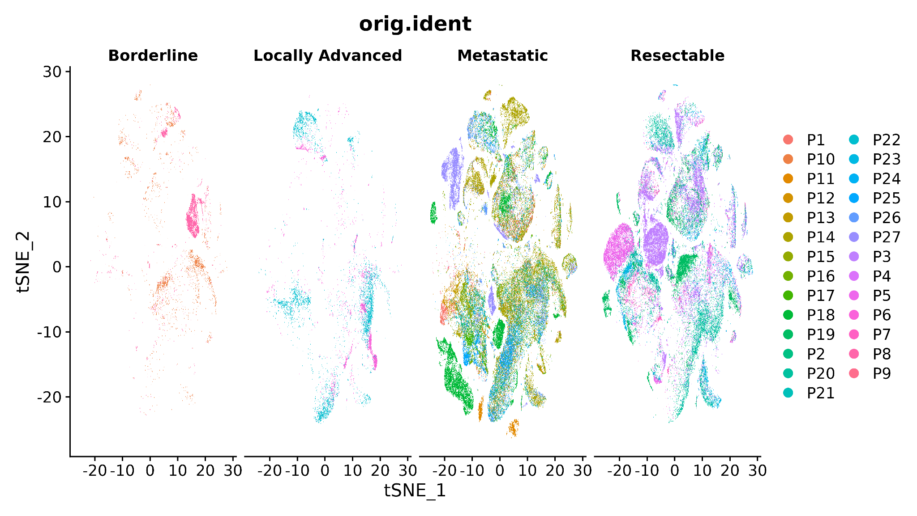

Slide 13
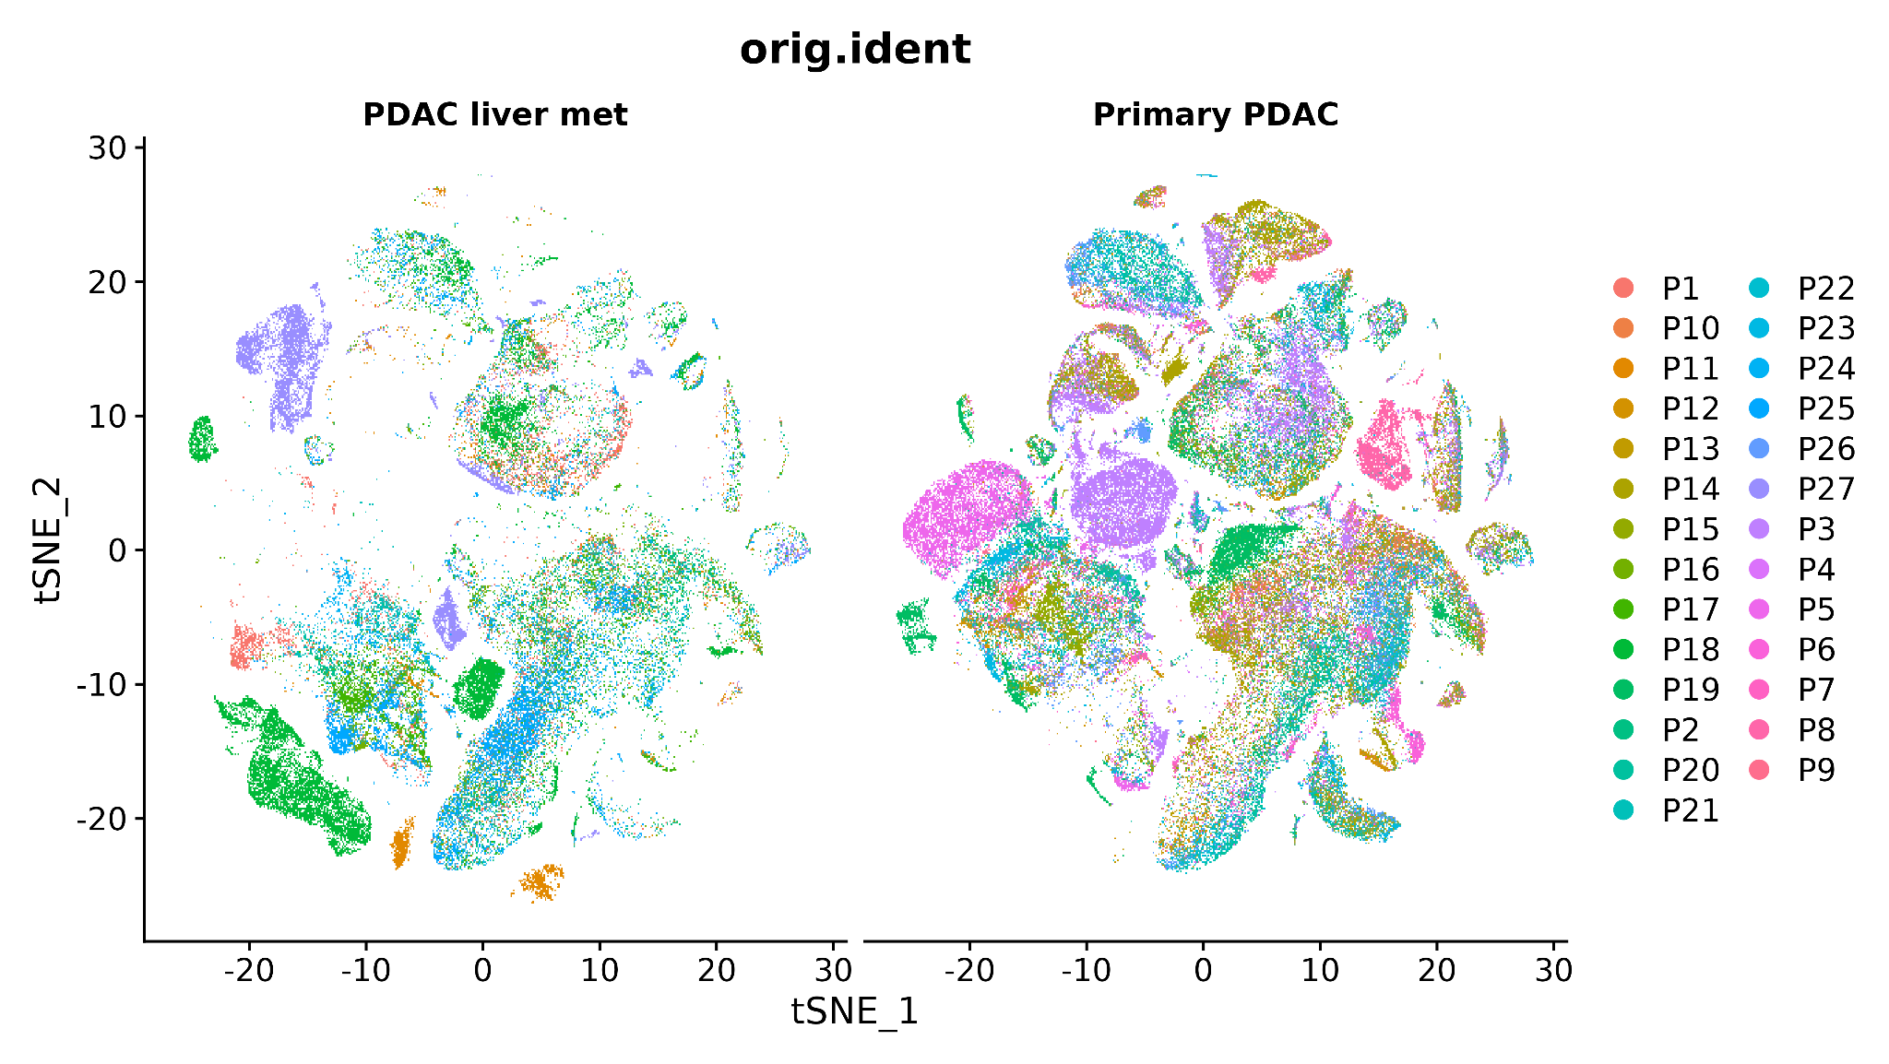

Slide 14
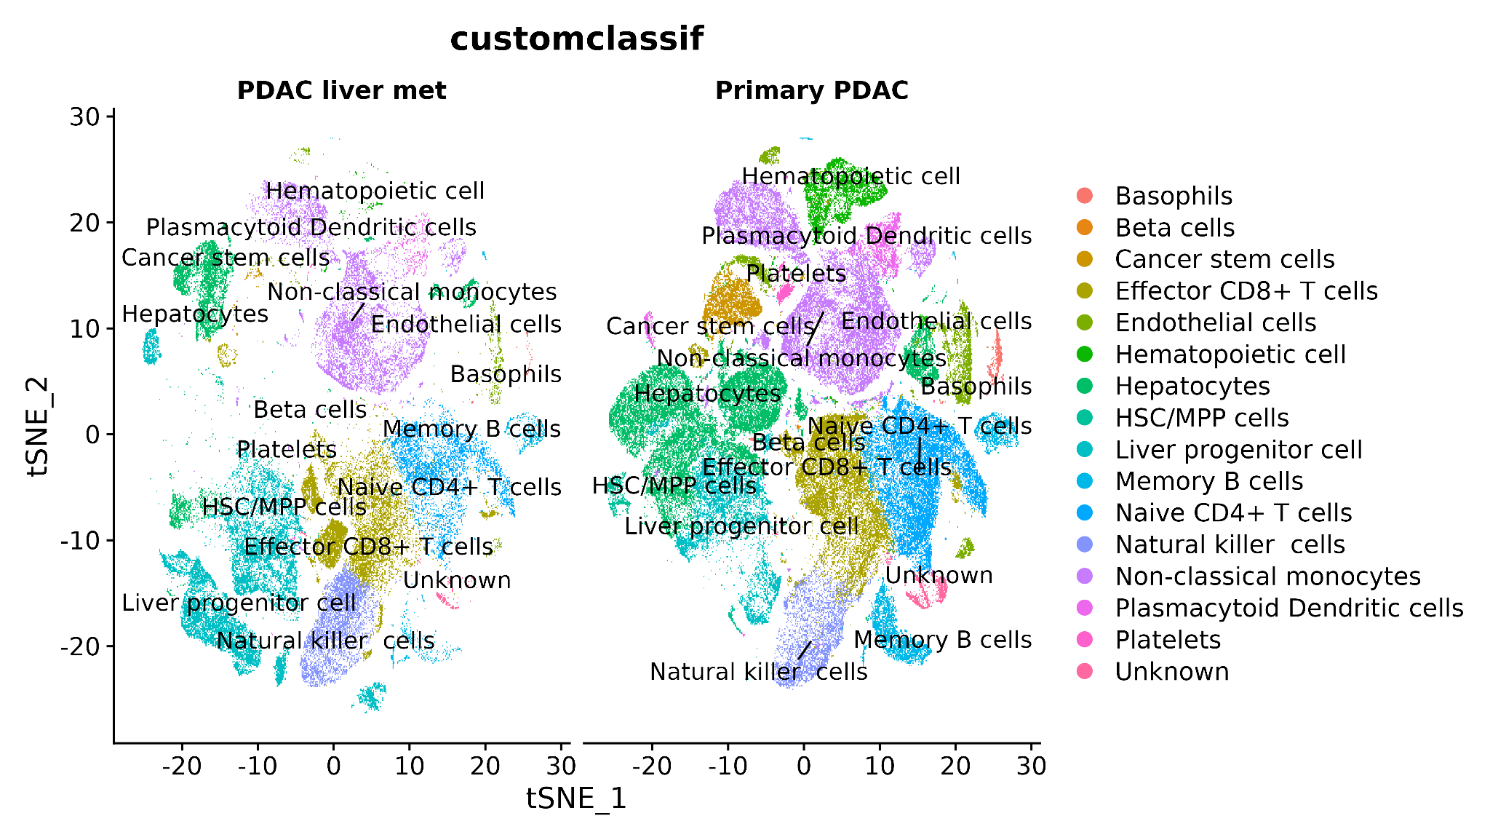
Notes:
It can be seen T-cells are present at both pre and post metastasis stage

Slide 15
Differential Gene Expression
Cell types | Upregulated | Downregulated
Basophils | 76 | 378
Beta cells | 454 | 190
Cancer stem cells | 553 | 117
Effector CD8+ T cells | 62 | 811
Endothelial cells | 345 | 80
Hematopoietic cell | 496 | 126
Hepatocytes | 594 | 83
HSC/MPP cells | 1665 | 61
Liver progenitor cell | 1998 | 74
Memory B cells | 79 | 327
Naive CD4+ T cells | 126 | 529
Natural killer cells | 162 | 388
Non-classical monocytes | 419 | 92
Plasmacytoid Dendritic cells | 320 | 44
Platelets | 66 | 350
Unknown | 24 | 2721

Slide 16
T-Cell types for Enrichment Analysis
Among all the cell subpopulations only T-cells (Effector CD8+ T cells, Naive CD4+ T cells, and Natural killer cells) were selected for identification of exhausted immune system (T-cells)
Cell types | Upregulated | Downregulated
Effector CD8+ T cells | 62 | 811
Naive CD4+ T cells | 126 | 529
Natural killer cells | 162 | 388
Notes:
T-cells were selected as T-cells are the main cell types involved in combating cancer cells; additionally, T-cells are involved in exhaustion mechanisms during cancer progression, resulting in immune system exhaustion.

Slide 17
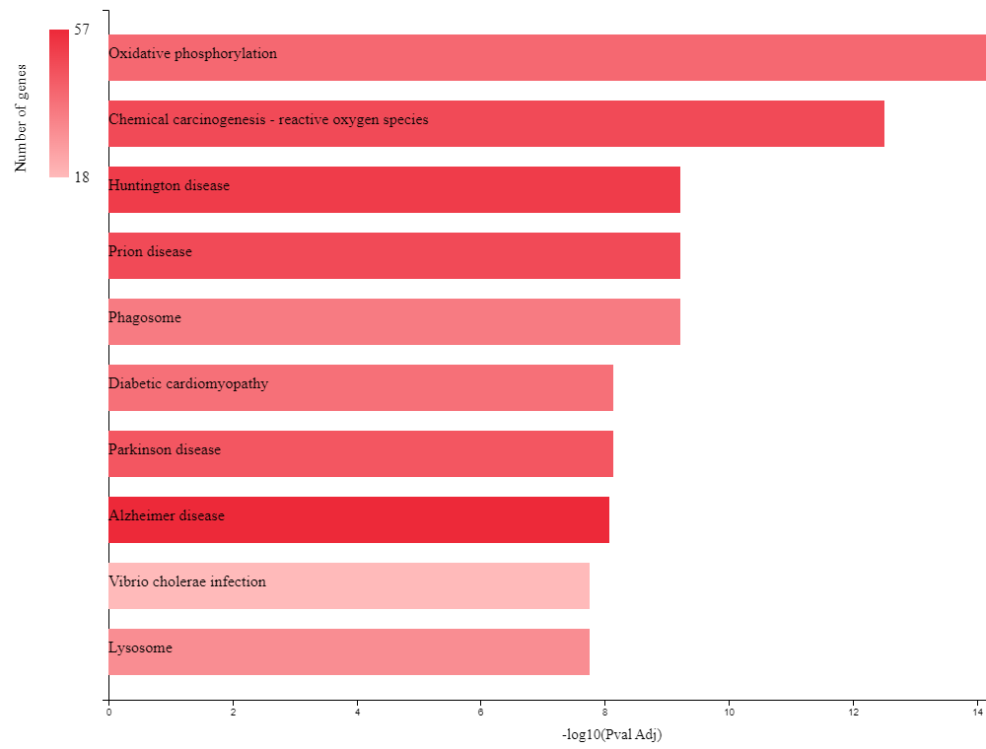
Functional Enrichment Analysis
Downregulated T-cells Genes
Oxidative phosphorylation and Chemical carcinogenesis, Reactive oxygen species pathways were implicated in poor survival in PDAC.

Slide 18
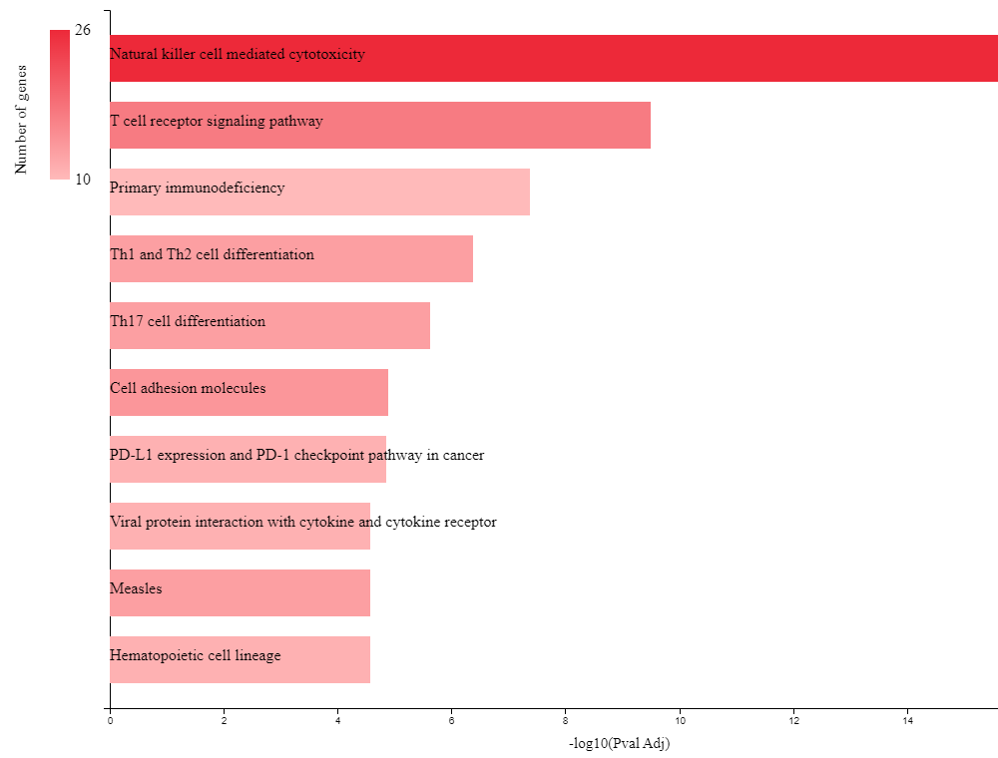
Functional Enrichment Analysis
Upregulated T-cells Genes
Among the upregulated KEGG pathways, T cell receptor signaling pathway, Th1 and Th2 cell differentiation, Th17 cell differentiation, and PD-L1 expression and PD-1 checkpoint pathway in cancer were implicated in poor survival in PDAC.
Notes:
This was verified through literature review

Slide 19
T-cell Exhaustion Genes Shortlisting
Shortlisted through literature review
Total 17 common genes were identified mentioned in Table, were subjected to functional enrichment analysis
Shortlisted genes
PRF1
GZMA
IFNG
CD160
TBX21
ZEB2
NR4A2
SLAMF7
CD8A
CD3D
NKG7
CCR7
IL7R
ID2
IL2RB
IL2RG
TGFB1

Slide 20
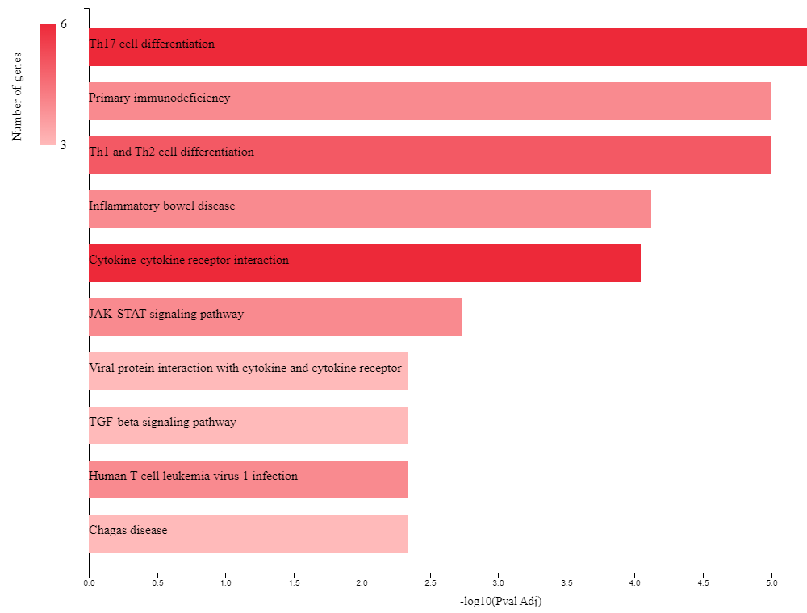
Functional Enrichment Analysis
Upregulated Exhausted T-cells Genes
The genes implicated in T cell exhaustion exhibited upregulation in various KEGG pathways, notably the TGF-beta signaling pathway
Pathways involved in poor survival, such as T cell receptor signaling, Th1 and Th2 cell differentiation, Th17 cell differentiation, and the PD-L1/PD-1 checkpoint pathway in cancer, exhibited concurrent upregulation in genes associated with T cell exhaustion.
Notes:
This was verified through literature review

Slide 21
T-cell Exhaustion Genes Shortlisting
Common genes
TBX21
TGFB1
CD3D
CD8A
IFNG
IL2RB
IL2RG
The identified 17 shortlisted genes were further compared to the T-cell exhaustion pathways implicated in poor survival, resulting in 7 common genes.

Slide 22
TCGA/GEPIA Expression Analysis Validation
Genes | Tumor | Normal
PRF1 | 2.82 | 0.32
GZMA | 7.96 | 0.32
IFNG | 0.08 | 0
CD160 | 0.18 | 0.11
TBX21 | 0.33 | 0.07
ZEB2 | 10.37 | 1.67
NR4A2 | 3.98 | 2.06
SLAMF7 | 5.65 | 0.14
CD8A | 4.05 | 0.69
CD3D | 9.89 | 0.41
NKG7 | 7.93 | 0.58
CCR7 | 2.12 | 0.2
IL7R | 7.61 | 0.67
ID2 | 56.82 | 20.47
IL2RB | 2.66 | 0.18
IL2RG | 61.42 | 0.75
TGFB1 | 50 | 5.3
The genes associated with T cell exhaustion exhibited higher expression levels in PAAD across TCGA datasets

Slide 23
Survival analysis
The genes associated with T cell exhaustion exhibited poor overall survival with higher expression levels in PAAD
Notably, only the ID2 gene exhibited better overall survival despite its higher expression

Slide 24
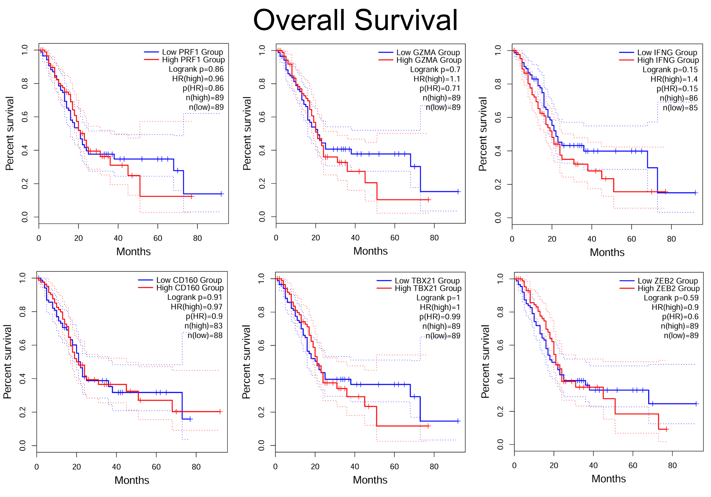

Slide 25
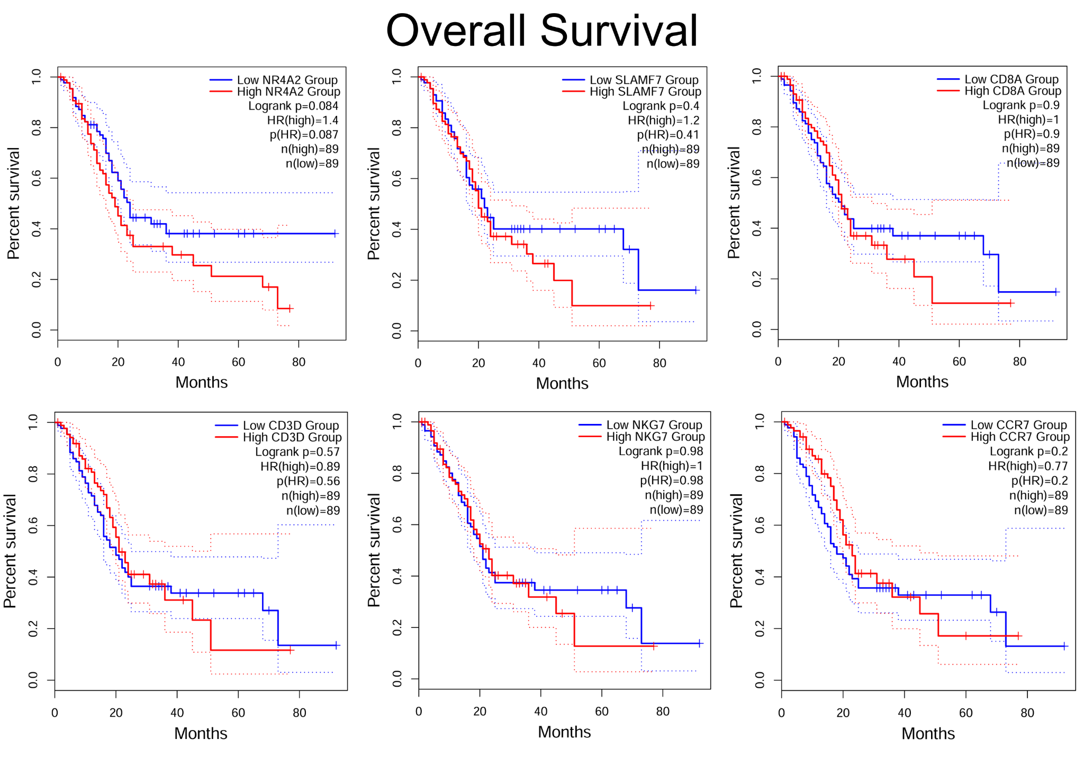

Slide 26
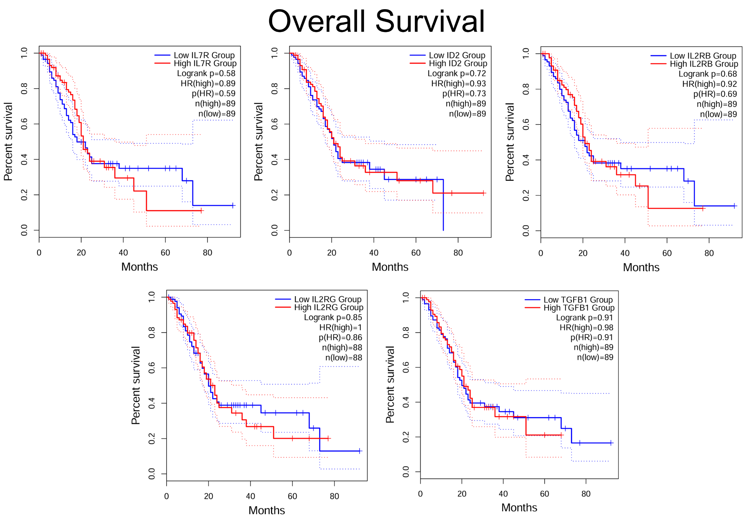

Slide 27
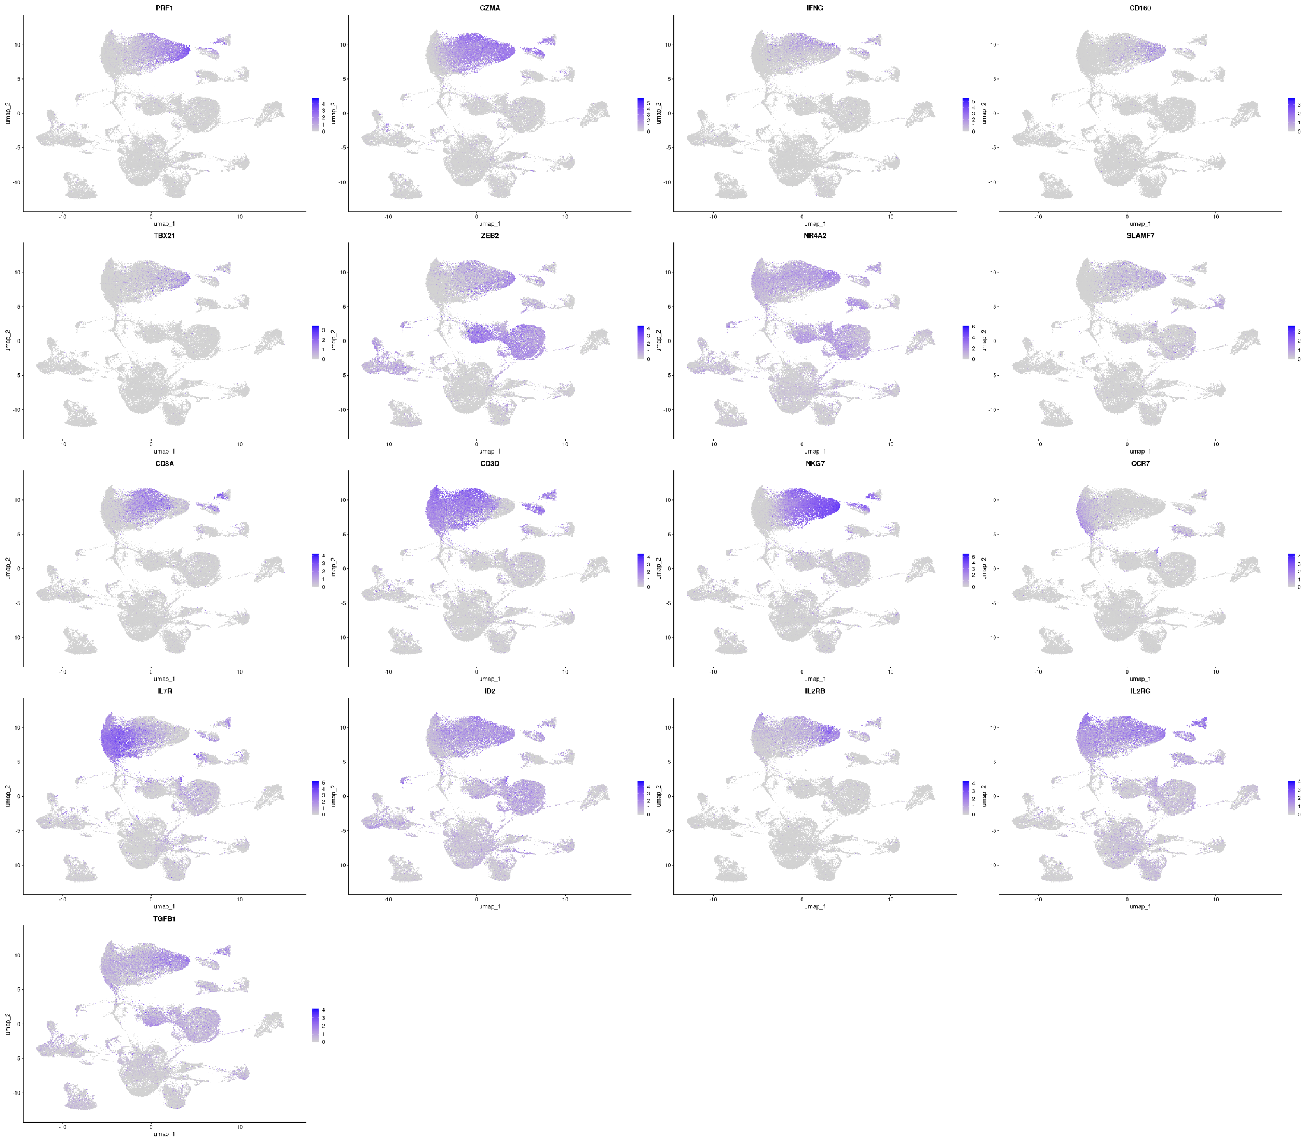
Feature Plot of Shortlisted Genes
Notes:
Feature plot of the 17 shortlisted genes showing the expression levels of each gene in all cell subpopulations.
It shows the expression level of genes in cell clusters.

Slide 28
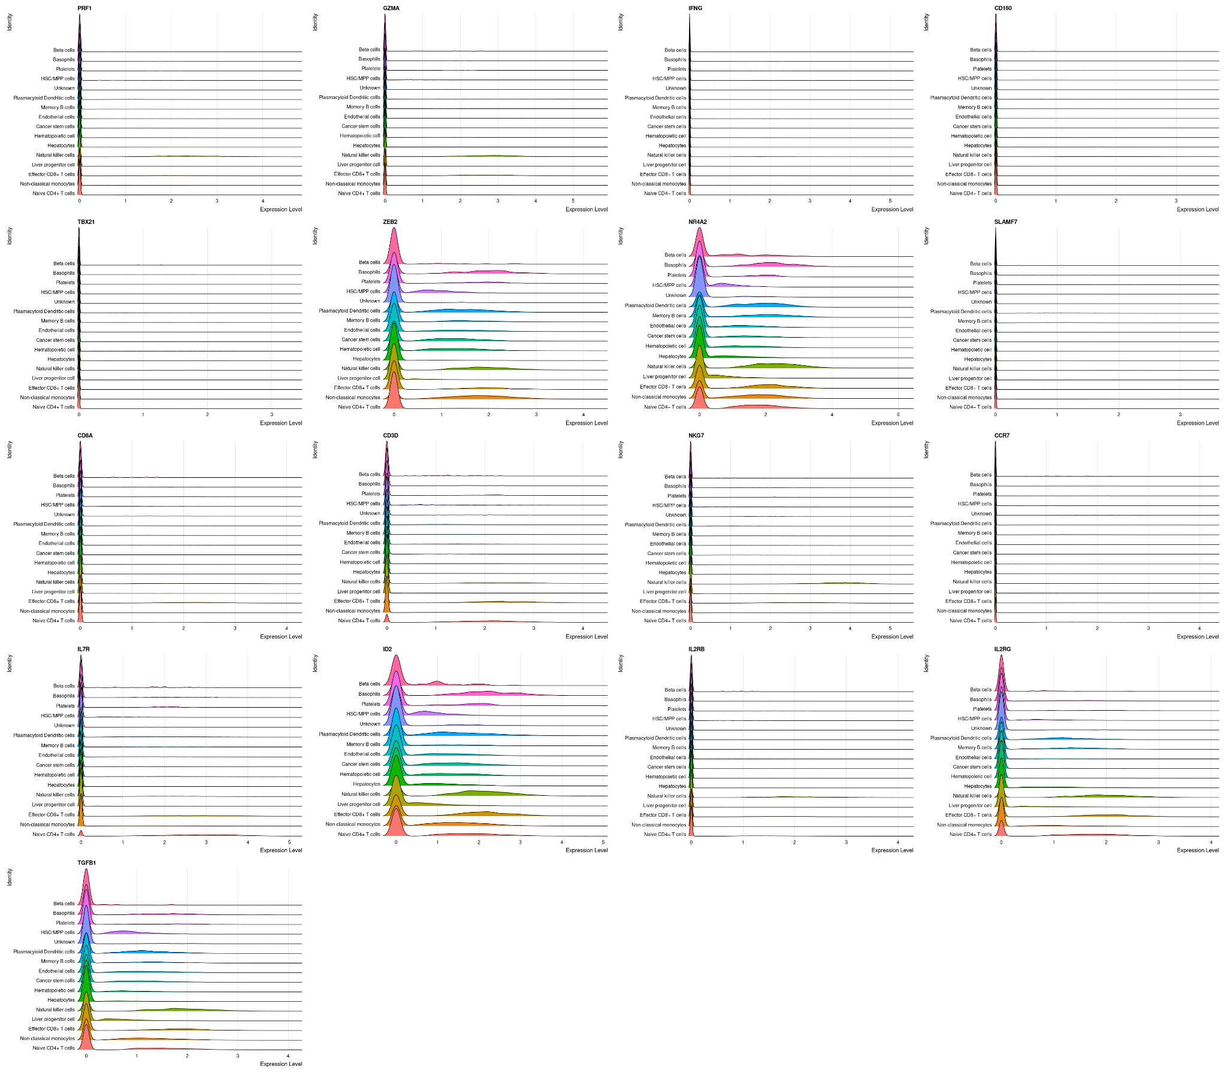
Ridge Plots of Shortlisted Genes
Ridge plots of the 17 shortlisted genes showing the expression levels of each gene in all cell subpopulations.
ZEB2, NR4A2, ID2, IL2RG, and TGFB1 showed significant higher expression levels in all cells

Slide 29
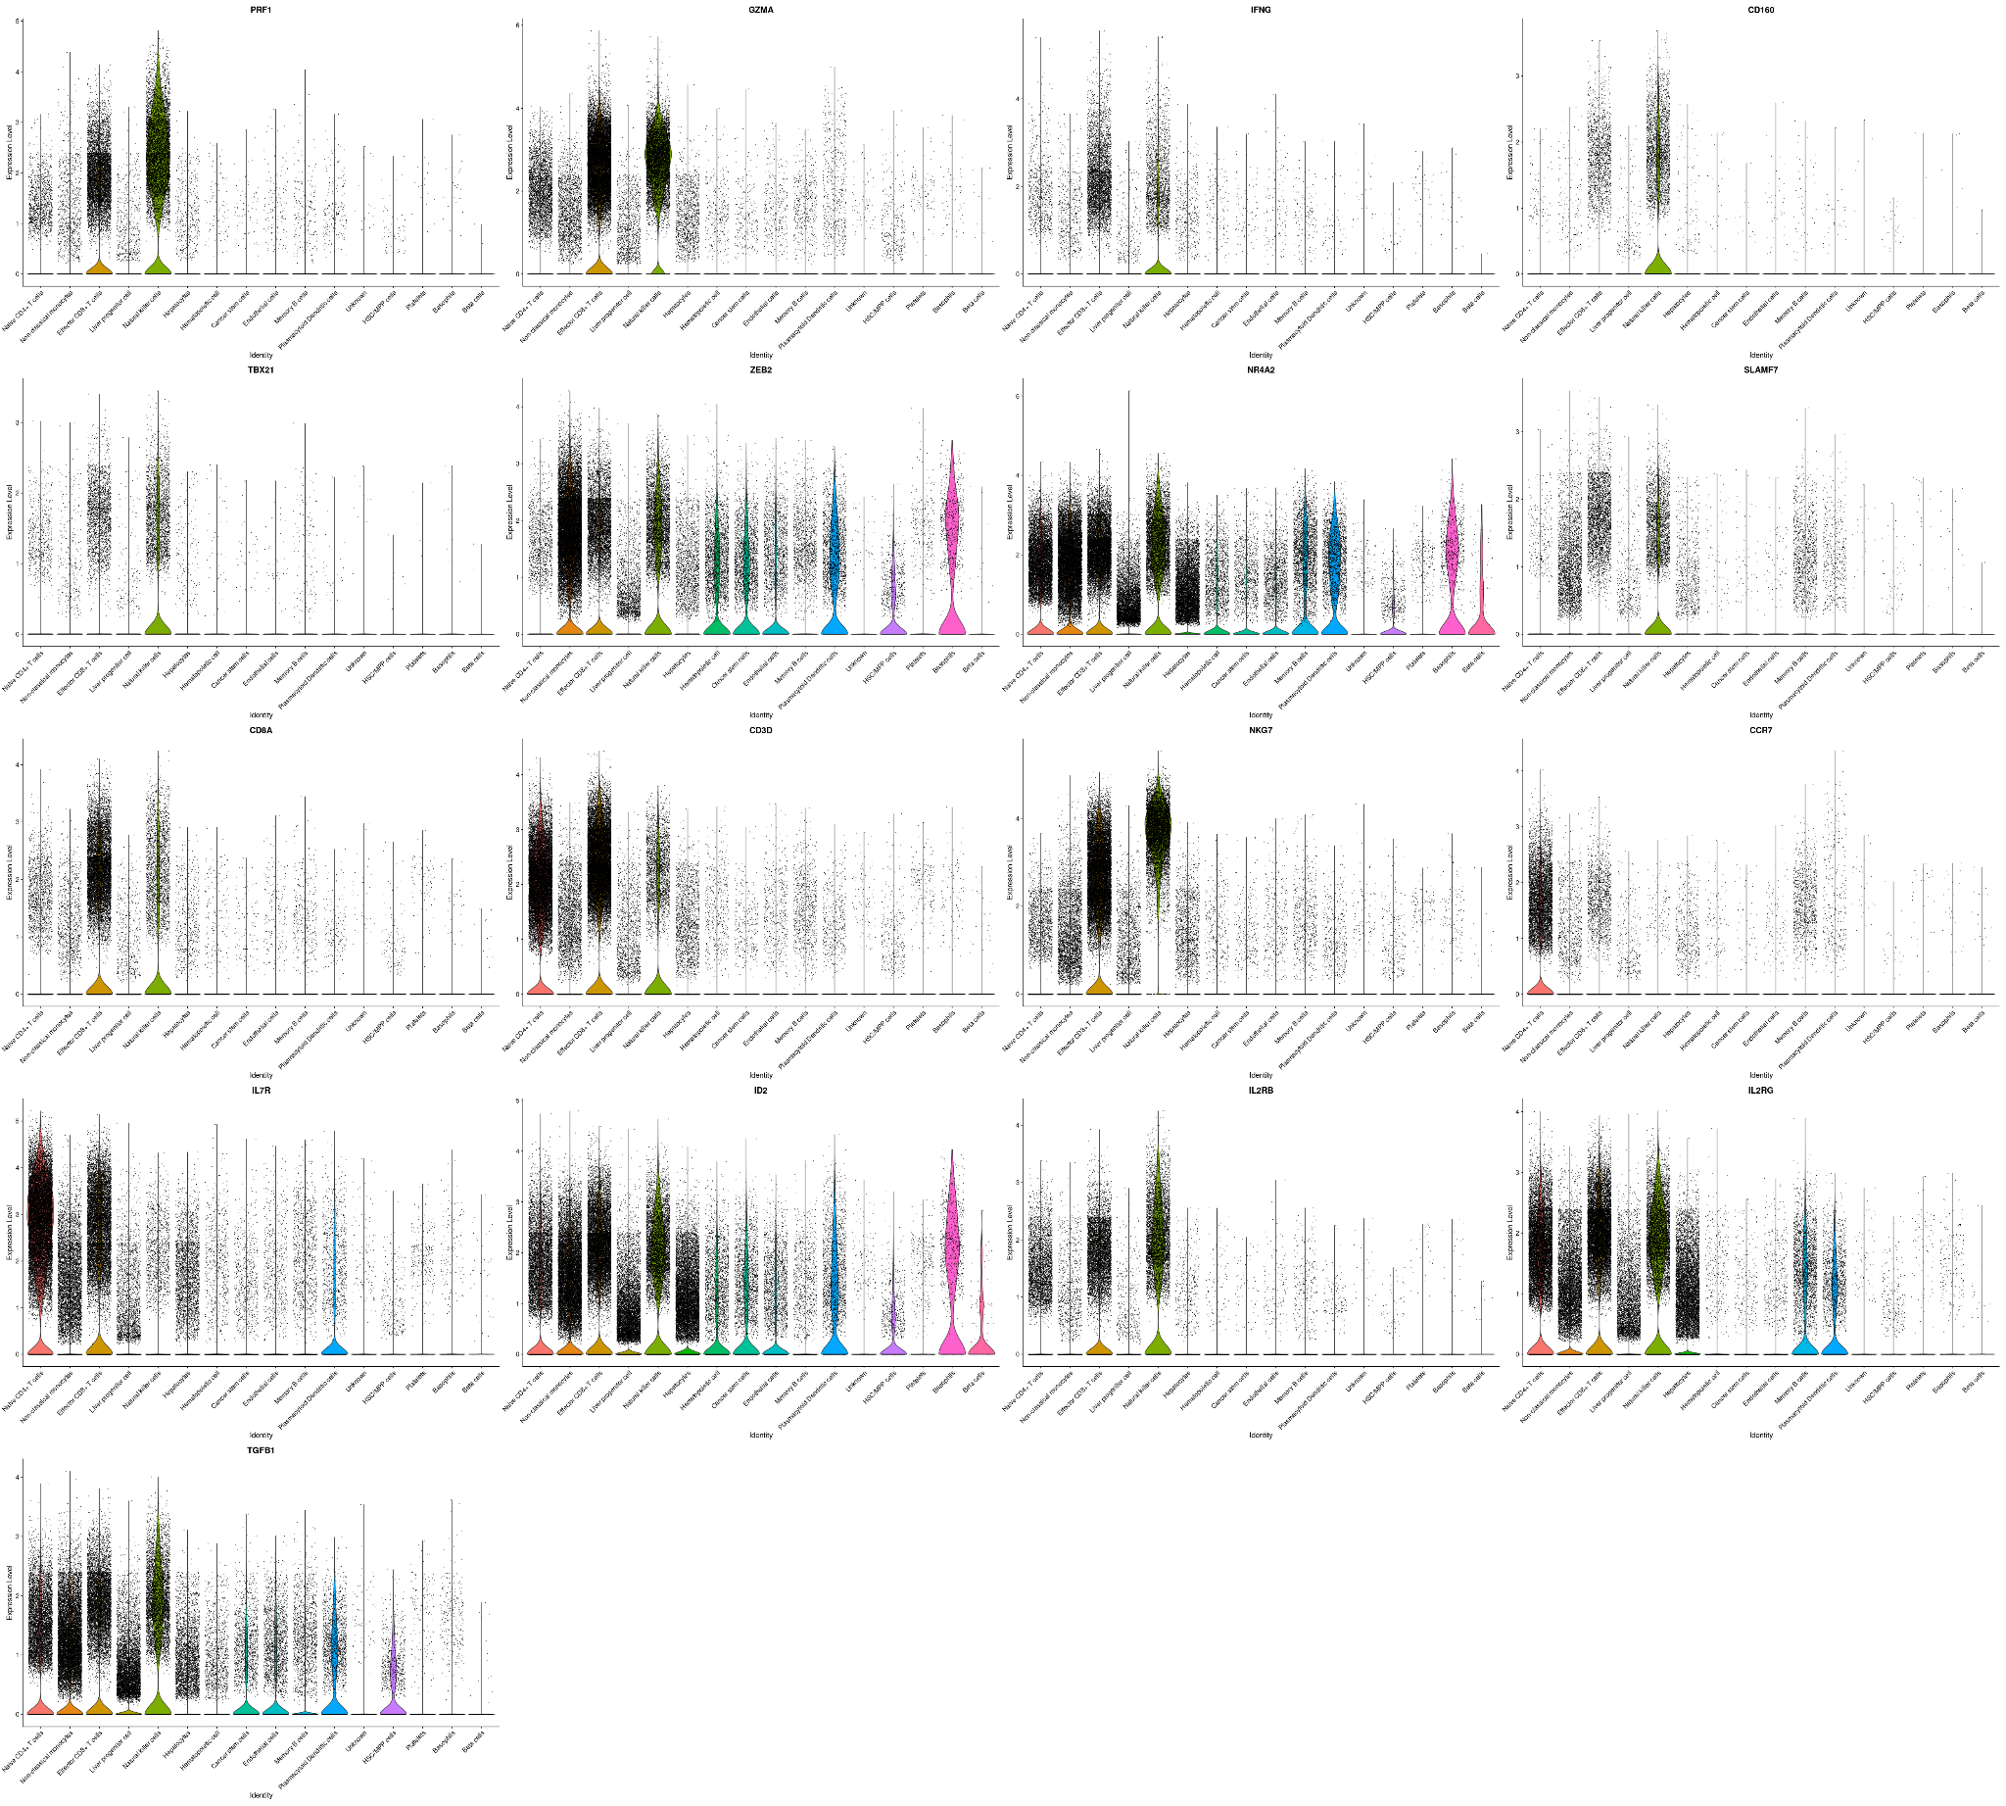
Violin Plots of Shortlisted Genes
Violin plots of the 17 shortlisted genes showing the expression levels of each gene in all cell subpopulations.
All the shortlisted genes were highly expressed in all three types of T-cells.

Slide 30
Conclusion
The T-cells exhaustive immune maker genes, PRF1, GZMA, IFNG, CD160, TBX21, ZEB2, NR4A2, SLAMF7, CD8A, CD3D, NKG7, CCR7, IL7R, ID2, IL2RB, IL2RG, and TGFB1 might be implicated in the exhaustion of the immune system in TME of PDAC patients, which can be targeted for better survival

